Slide 1

COVID-19 Socioeconomic Analysis 17 OCT 2020
Connor Berek
Alex Fernandez
Justin Forkert
Mike Grad
Xi Zhang

Slide 2

Project Goals
Describe
Relationship between Covid-19 infection rates and mortality rates with income level
Describe
Relationship between Covid-19 infection rates and mortality rates with latitude in the US
Describe
Relationship between Covid-19 infection rates and mortality rates with population

Slide 3

Methodology for Analysis
Sourcing
Cleansing
Coding

Slide 4

Project Goals – Questions to Answer
Describe the relationship between Covid-19 infection rates and mortality rates with income level
Describe the relationship between Covid-19 infection rates and mortality rates with latitude in the US
Describe the relationship between Covid-19 infection rates and mortality rates with population

Slide 5
Methodology: Data Cleansing
Covid-19 data, median income, and median population data cleaned using pandas and converted into a clean csv for use in the mapping and charting of the data.
Sources: https://covid.cdc.gov/covid-data-tracker/#cases_totalcases, https://apps.bea.gov/iTable/iTable.cfm?reqid=70&step=1&isuri=1&acrdn=1#reqid=70&step=1&isuri=1&acrdn=1,

Slide 6
Methodology: Data Sourcing
Source: CDC Data Sets
Covid-19 infection and mortality rates broken down by state within the United Stateshttps://data.cdc.gov/Case-Surveillance/United-States-COVID-19-Cases-and-Deaths-by-State-o/9mfq-cb36

Slide 7
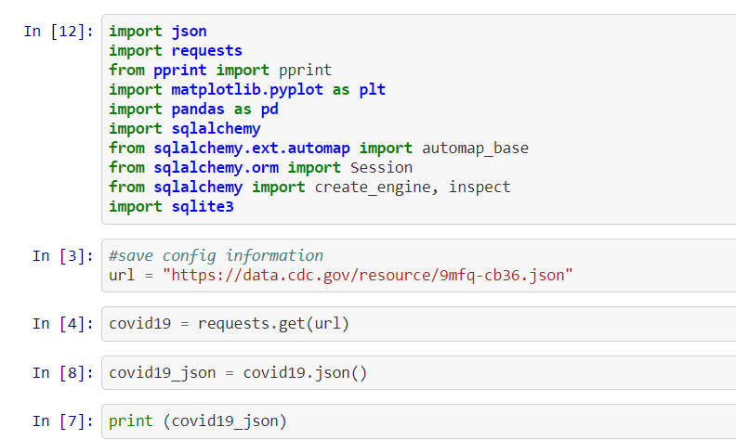
Methodology: Data Sourcing
Get Dynamic Covid 19 data through API

Slide 8
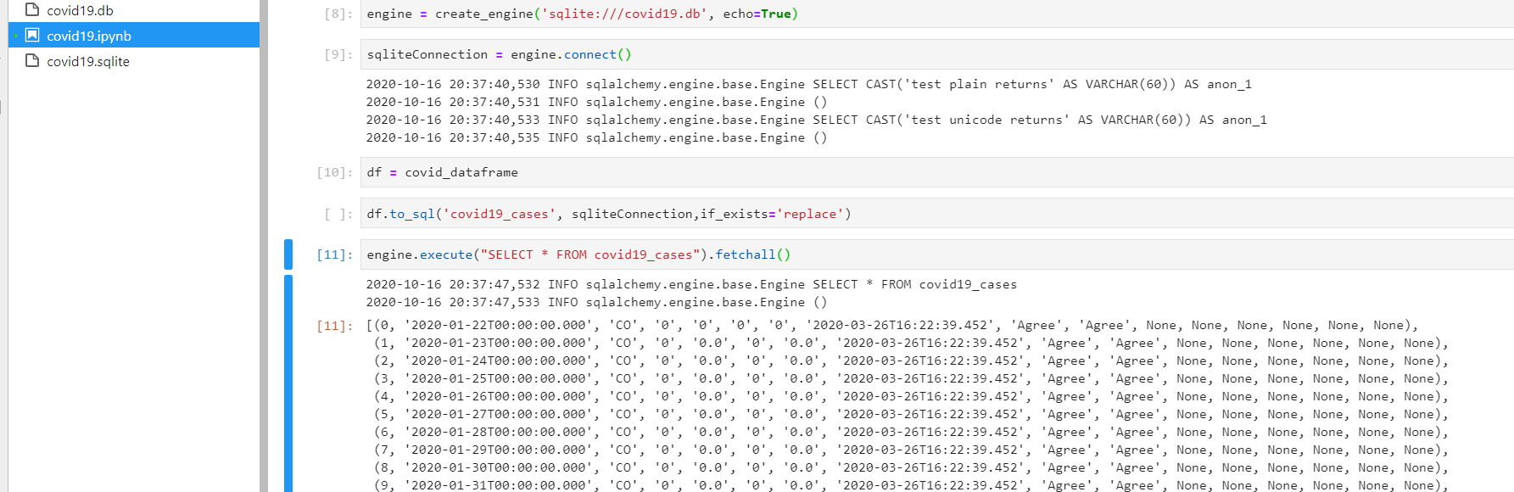
Methodology: Data Sourcing
Create data frame
Save as sqlite file

Slide 9
Methodology: Data Sourcing
Source: Kaggle Data Sets
Latitude and Longitude by state
Downloaded as csv
Source: BEA.gov
Median income and population
Downloaded as a csv

Slide 10
Methodology: Flask
Using SQLite3, we established a connection to the Covid-19 data that was generated from the API call and covid19.sqlite.
From there, we were able to query the table and selected submission_date, state, new_case from the covid19.sqlite database.

Slide 11
Methodology: Coding HTML & CSS
HTML was structured using Bootstrap to created a dashboard layout
Nav Links/Buttons/Forms/Searches
Charts / Maps / Trackers

Slide 12
Methodology: Coding JavaScript Outputs
Maps
Infection Rates across US or selected state with Popup (US only)
Mortality Rates across US or selected state with Popup (US only)
Timeseries plot of selected state infection/mortality rates
Plots
Infection Rate by Latitude for US or state
Mortality Rate by Latitude for US or state
Infection Rate by Median Income
Mortality Rate by Median Income

Slide 13
Methodology: Coding JavaScript Outputs cont’d
Covid-19 Tracker
Use Search Bar or Click on Map
Update textbox with Statistics
Infection Rate
Mortality Rate
Median Income
Population
Prepopulate with current US data

Slide 14
Methodology: Coding JavaScript Functionality
Selectors
Map: Infection Rates or Mortality Rates
Charts: Plots by Latitude
Datasets: Covid-19 data or income/population data
Form textbox search by state
Click on map to update all charts by state
Current Covid-19 stats: markers with infection rates and mortality rates by state
Color coding by level of infections/mortality

Slide 15

Challenges
The team experienced the following challenges during the project
Connecting SQLite database using flask.

Slide 16

Conclusions
Covid-19 vs. Latitude
No relationship for infection rate and mortality
Covid-19 vs. Median Income
No relationship for infection rate and mortality
Covid-19 vs. Population
Positive relationship between both infection rate and mortality rate and the population size

Slide 17

Questions

